Slide 1
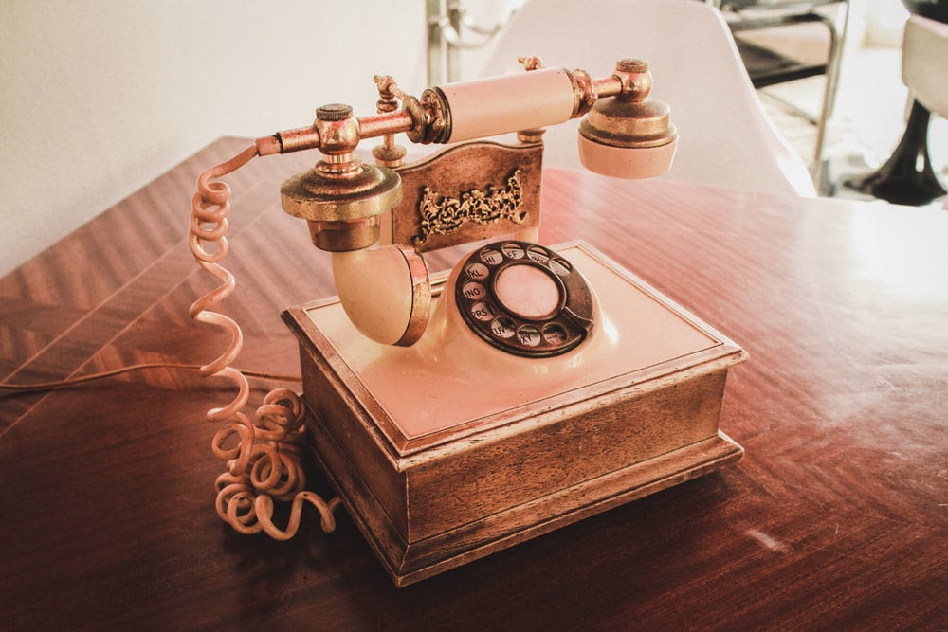
Conversation Class
Past tense
Christopher bAUMAN

Slide 2
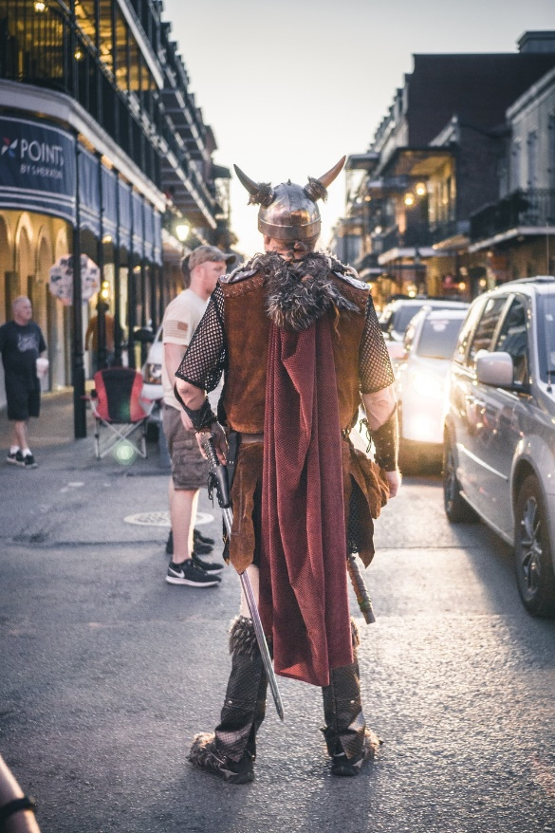
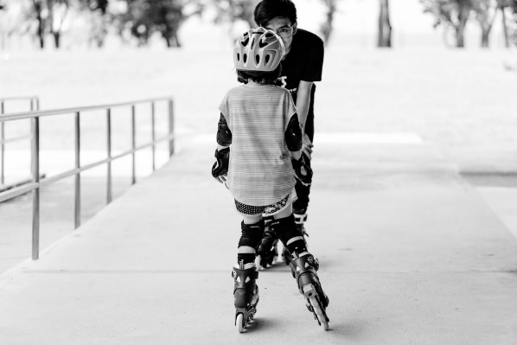
Education Infographic
Learning
Change
Luck
Unusual
Adventure
Belongings
Smile
Unexpected
Popcorn
Backpack
Transport
Lost / found
Balloon
Teachers
Education
Skills
Chris Bauman

